Slide 1
Capstone of Geoffrey Leigh
Statistics & Modeling
Coding with Performance on Big Data
Communicating Results for Decision-Making
Venn Diagram of Data Science Skills

Slide 2
Contribution of Competitor’s Article
Title: Particulate air pollution as a predictor of mortality in a prospective study of US adults.
Authors: CA Pope III, MJ Thun, Mohan M Namboodiri, DW Dockery, JS Evans, FE Speizer, CW Heath Jr
Methods: Uses Time-series, cross-sectional, and other studies using between mortality and particulate air pollution
Data: Deaths were ascertained through December, 1989.
Exposure to sulfate and fine particulate air pollution, which is primarily from fossil fuel combustion, was estimated from national data bases.
Summary: US adults found significant associations between
lifetime exposures to Sulphate aerosols and fine particles, as judged by community air pollution data, and some causes of mortality.
Conclusion: It reinforced earlier findings of significant associations, on a daily basis, between exposures to fine particles and mortality, and showed that cardiopulmonary and lung cancer mortality were significantly related to particulate air pollutants.

Slide 3
Description of Your Contribution
Using Time Series Analysis to make a prediction from historical data supplied from sensor data.
From the aggregated dataset, separate the time into 3 categories: Morning (6am to 2pm), Midday (2pm to 10pm) and Night (10pm to 6am) from one sensor station.
Build a program to create a binary prediction (one week forward).
Create a visualization that can be easy to understand to the general public

Slide 4
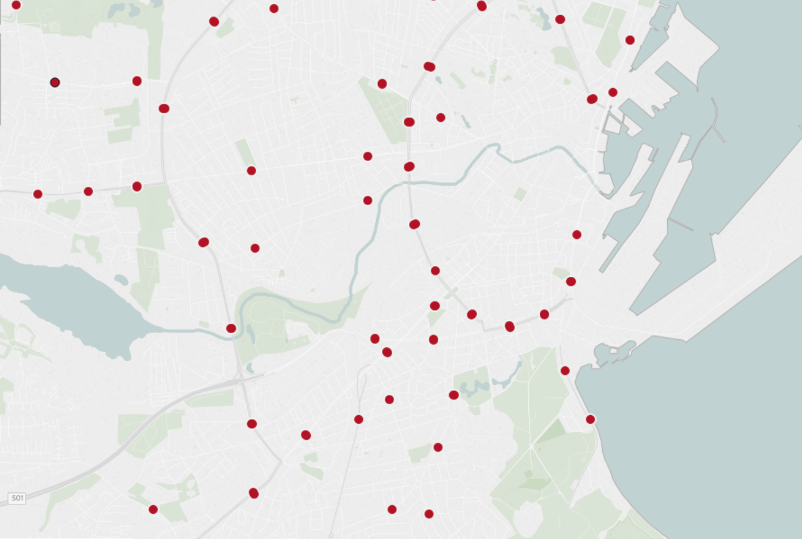
Data Source and Content
Dataset supplied by: http://iot.ee.surrey.ac.uk:8080/datasets.html
Variables: Carbon Monoxide, Particulate Matter, Sulfate Dioxide, Nitrogen Dioxide
Observation points: ~449
Location: City of Brasov in Romania
Date Range: August 2014 - October 2014
Time cycles: 24hrs periods
Carbon Monoxide – CO
Primary pollutant, emitted by incomplete combustion of biomass or fossil fuels
Emissions reduction by higher temperature combustion and use of catalytic converters on motor vehicles
Nitrogen Dioxide – NO₂
Formed by oxidation of NO, which is produced with high temperature combustion (NO₂ is a secondary pollutant)
Sulfur Dioxide – SO₂
Primary pollutant, emitted by combustion of fuels containing sulfur; also metal smelting
Particulate Matter - PM
Products of combustion, atmospheric reactions, and mechanical processes
Wide range of particle sizes

Slide 5
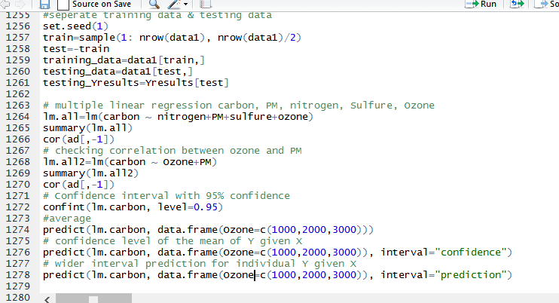
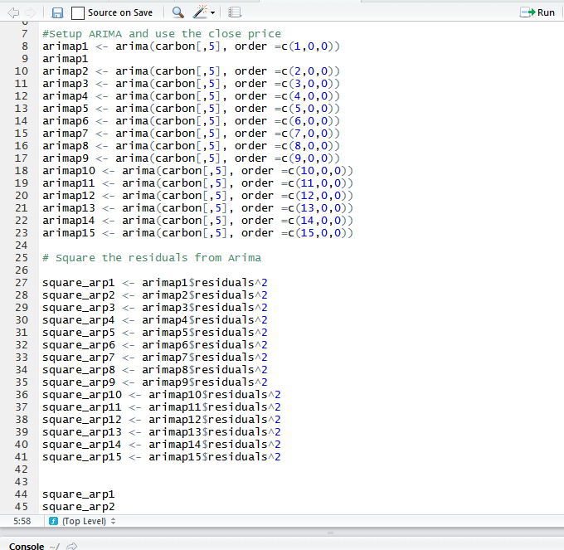
Your Method
Upload the dataset
Normalize it (scale it) equation
Analysis (training, testing and exploring data)
Predict (LM and Time Series Analysis)
ARIMA: AutoRegressive Integrated Moving Average
Conclusion and Visualization (Make sense of the data)
Future research: Incorporate other data sets to the project (Traffic)

Slide 6
Capstone: Air Pollution Focus
The natural atmosphere
Outdoor pollutants and their sources
Indoor air pollution
Health effects of air pollution
Measurement of particle pollution
Climate change

Slide 7
Similar to other studies but not as specific
Carbon monoxide (yes)
Sulfur dioxide (yes)
Nitrogen dioxide (yes)
Volatile organics (NO)
Ozone (NO)
Particulate matter (some)
Sulfates, nitrates, organics, elemental carbon, lead and other metals

Slide 8
Nitrogen Dioxide – NO₂
Formed by oxidation of NO, which is produced with high temperature combustion (NO₂ is a secondary pollutant)
Oxidant that can irritate the lungs and hinder host defense
A key precursor of ozone formation
Emissions reductions by engine redesign and use of catalytic converters

Slide 9
Sulfur Dioxide – SO₂
Primary pollutant, emitted by combustion of fuels containing sulfur; also metal smelting
Irritates upper respiratory tract
Converted in atmosphere to acid sulfates
Emissions reductions by building taller smoke stacks, installing scrubbers, or by reducing sulfur content of fuel being burned

Slide 10
Carbon Monoxide - CO
Colorless, odorless gas
Primary pollutant, emitted by incomplete combustion of biomass or fossil fuels
Binds strongly with hemoglobin, displacing oxygen
Emissions reduction by higher temperature combustion and use of catalytic converters on motor vehicles

Slide 11
Particulate Matter - PM
Products of combustion, atmospheric reactions, and mechanical processes
Wide range of particle sizes
Wide range of physical/chemical properties
Wide range of health impacts, including premature death
Control by filtration, electrostatic precipitation, and reduction of precursor gases

Slide 12
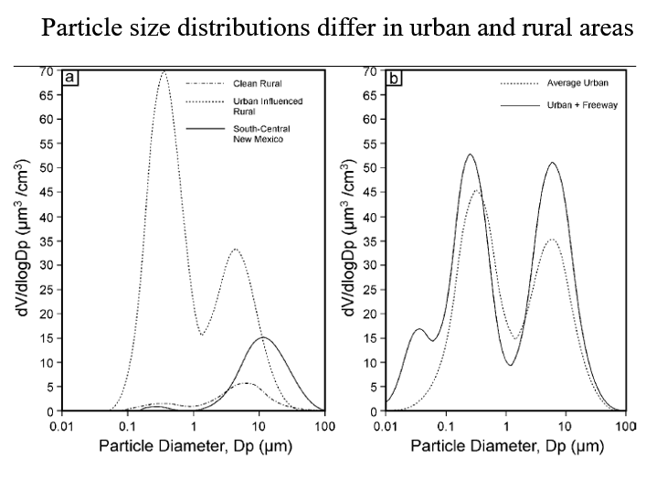
Competitors focus on Urban and Rural

Slide 13
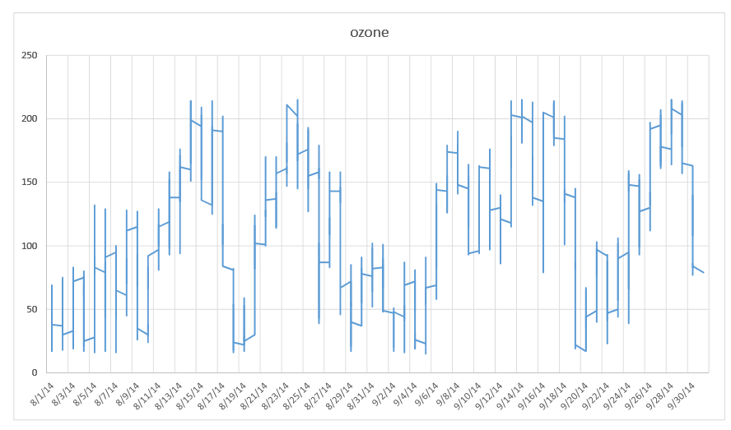
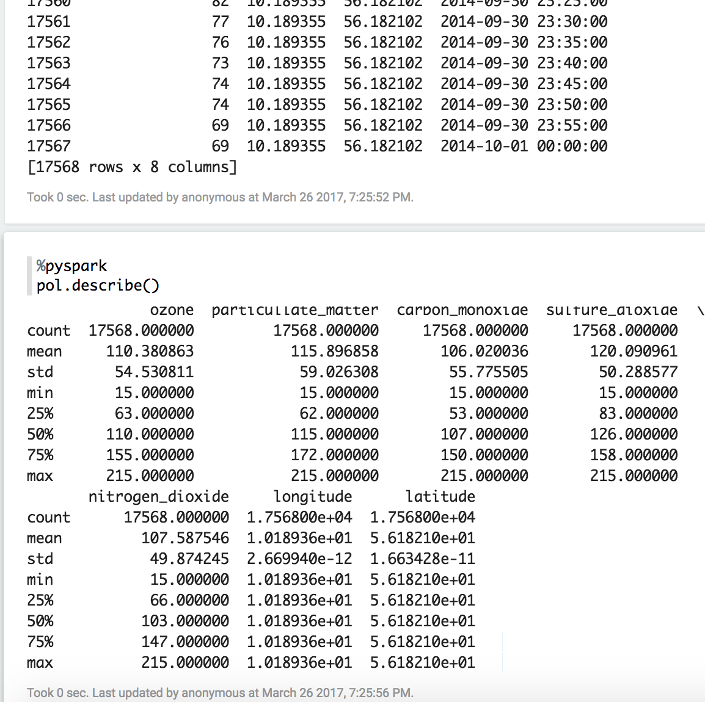
Quantitative Results 1
After many iterations in exploring the data, decided to slice up the data set into weeks and break them up to 3 equal parts: Morning, Midday and Night
Used zeppelin and R to normalize data and get some statistical data. Used describe() function to get my results.
Used Linear Regression model LM function in R, using Carbon as my Y variable and Ozone, PM, Nitrogen and Sulfate as my independent variables.
Then used Times series analysis to see if the following week I could make a prediction.

Slide 14
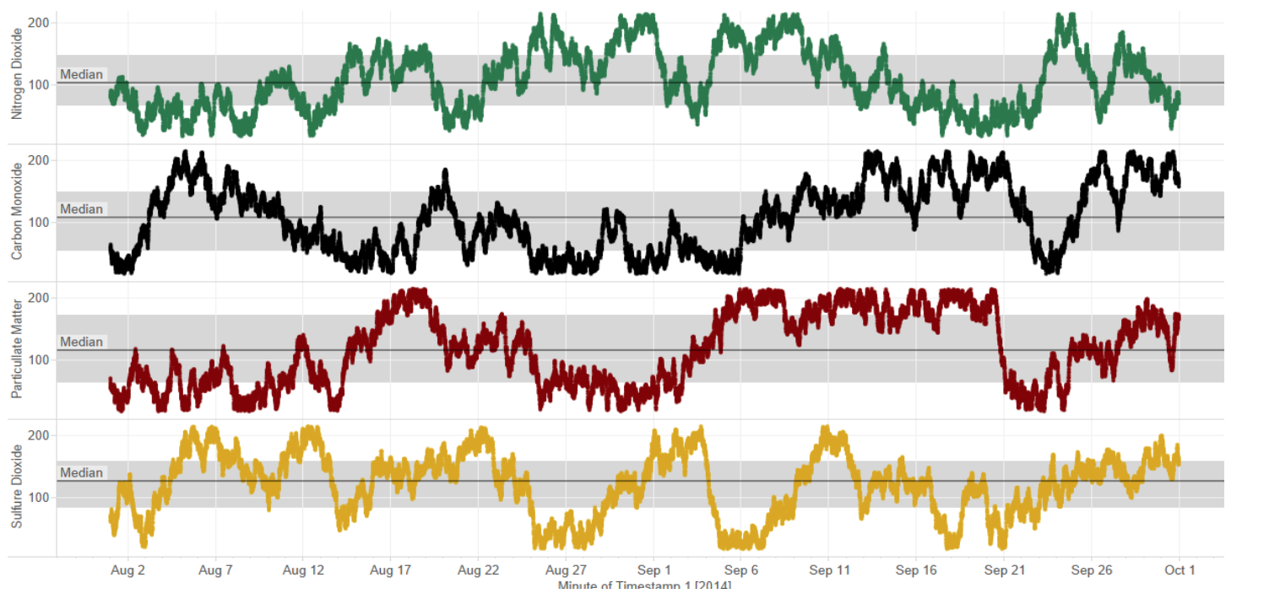
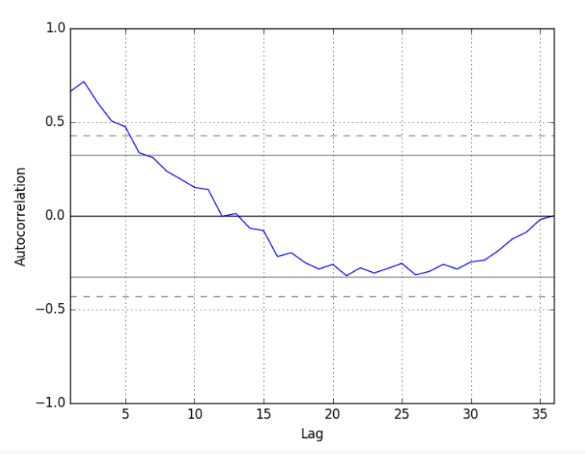
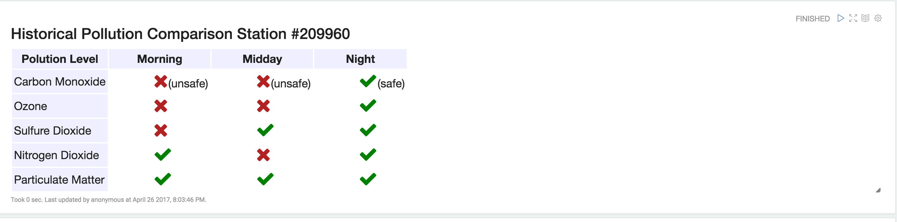
Quantitative Results 2
Normalized the data and plotted both training and test data. Wanted to see how all variables compared to each other.
There is a positive correlation with the first 10-to-12 lags that is perhaps significant for the first 5 lags. A good starting point for the AR parameter of the model may be 5.

Slide 15
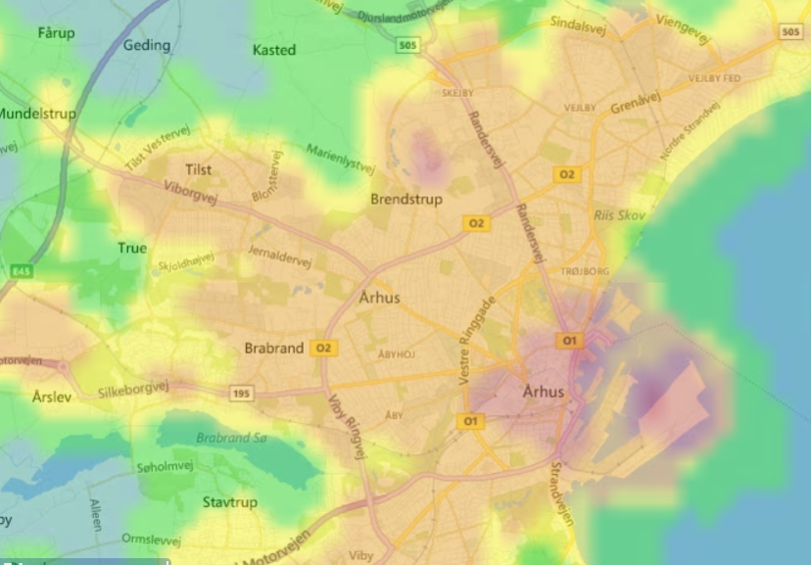
Our study will focus on the area where is the pollutant is most prevalent

Slide 16
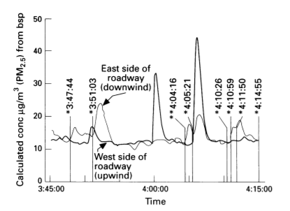
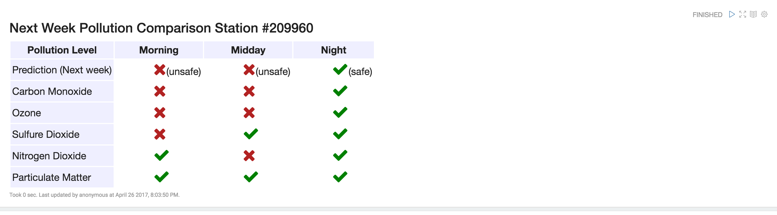
Discussion: Comparison With Your Competitor
Competitor’s Results
Your Results
From historical senor data able to produce a prediction for the following week.
As my competitor focused on mortality rate using pollution, my focus was mainly time of day predications using times series analysis.
Calculations based on these observations suggest that a
diesel bus with a low exhaust emits 50 times more PM2 5
than an automobile.
Spike in difference between a car and a bus going by

Slide 17
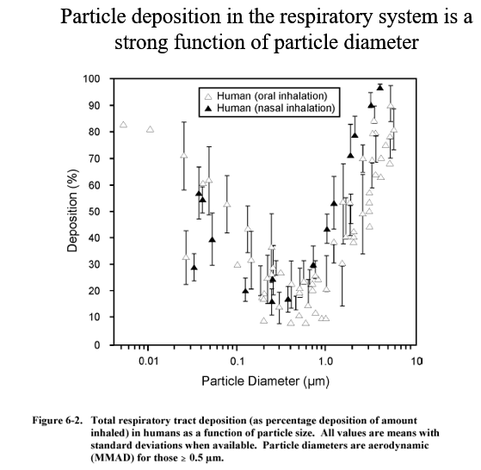
Competitor focus on health effect of pollution

Slide 18
Performance on Big Data: Time Measurements
Uploading data time manually (each csv ~22 sec X ~449 station= too long)
Using Zeppelin, to upload the csv. (3 seconds)
Cleaning dataset (2 mins); data was very clean, no NAs.
*Exploratory data analysis (many hours)
Using R to run analysis on data sections (<15 secs each)
Visualization time when data is uploaded to Zeppelin (1 sec)
Visualization time when data is uploaded to Tableau (25 secs)

Slide 19
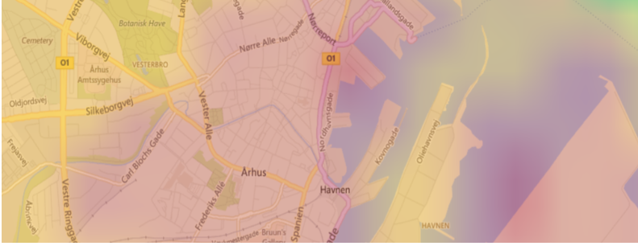
Investigate which routes and time where levels are high

Slide 20
Conclusion
Results: From the pollution data set, the program could make a binary prediction of next week’s pollution forecast (safe or unsafe) based on the historical data provided. Accuracy rate is 0.68 based on the test data.
Future work: using Logistic Regression Analysis on the dataset or other methods.
Use: This would be useful for city planners to determine where are hot spots of pollution within a city and could determine where not to build a school.

Slide 21
Quiz for Your Classmates
What statistical method was used?
What programming tool was used?
What scientific contribution was made?
What idea could be useful for your project?

